Slide 1


South Coast Golf Tour
The Opportunity To Experience The South Coast’s Golf Courses

Slide 2
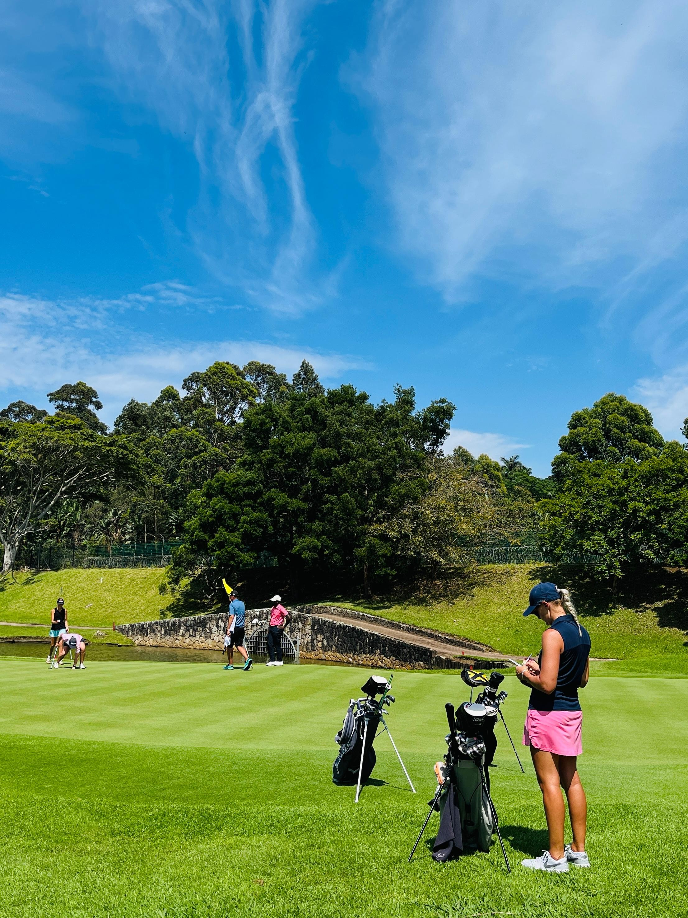
The Opportunity To Experience The South Coast’s Golf Courses
DAY
ACTIVITY | EXPERIENCE / UNIQUE OFFERINGS | CONTACT DETAILS
Umkomass Golf Club | The course design capitalises on the natural contours of the land and takes advantage of the glorious sea views - in fact, all but one of the holes offer great views of the warm Indian ocean. Although not overly long, the course offers a great challenge for low handicappers, especially when the coastal winds blow. Kids Golf As a family-friendly club we're committed to developing the next generation of golfers. For the past few years Umkomaas has hosted a weekly golf clinic for youngsters hosted by our resident golf coach | +27 (0)39 9731042 info@umkomaasgolf.co.za
Scottburgh Golf Club | Our 18-hole gem offers breathtaking views, challenging play, and a warm, welcoming vibe. Whether you’re here for a round or to soak in the scenery, you’ll feel right at home. We take pride in being an inclusive club where everyone is welcome male or female, young or old. Our members enjoy access to weekly competitions, social golfing events like Friday 5-pin, and reduced green fees on Monday, Tuesday, Thursday, Friday, and Sunday afternoons. Don’t miss our generous off-peak green fee specials! Our vibrant ladies’ section actively participates in weekly club competitions, local leagues, and prestigious KZN tournaments, including the annual Inter Club | 087 150 1312 accounts@scottburghgolf.co.za

Slide 3
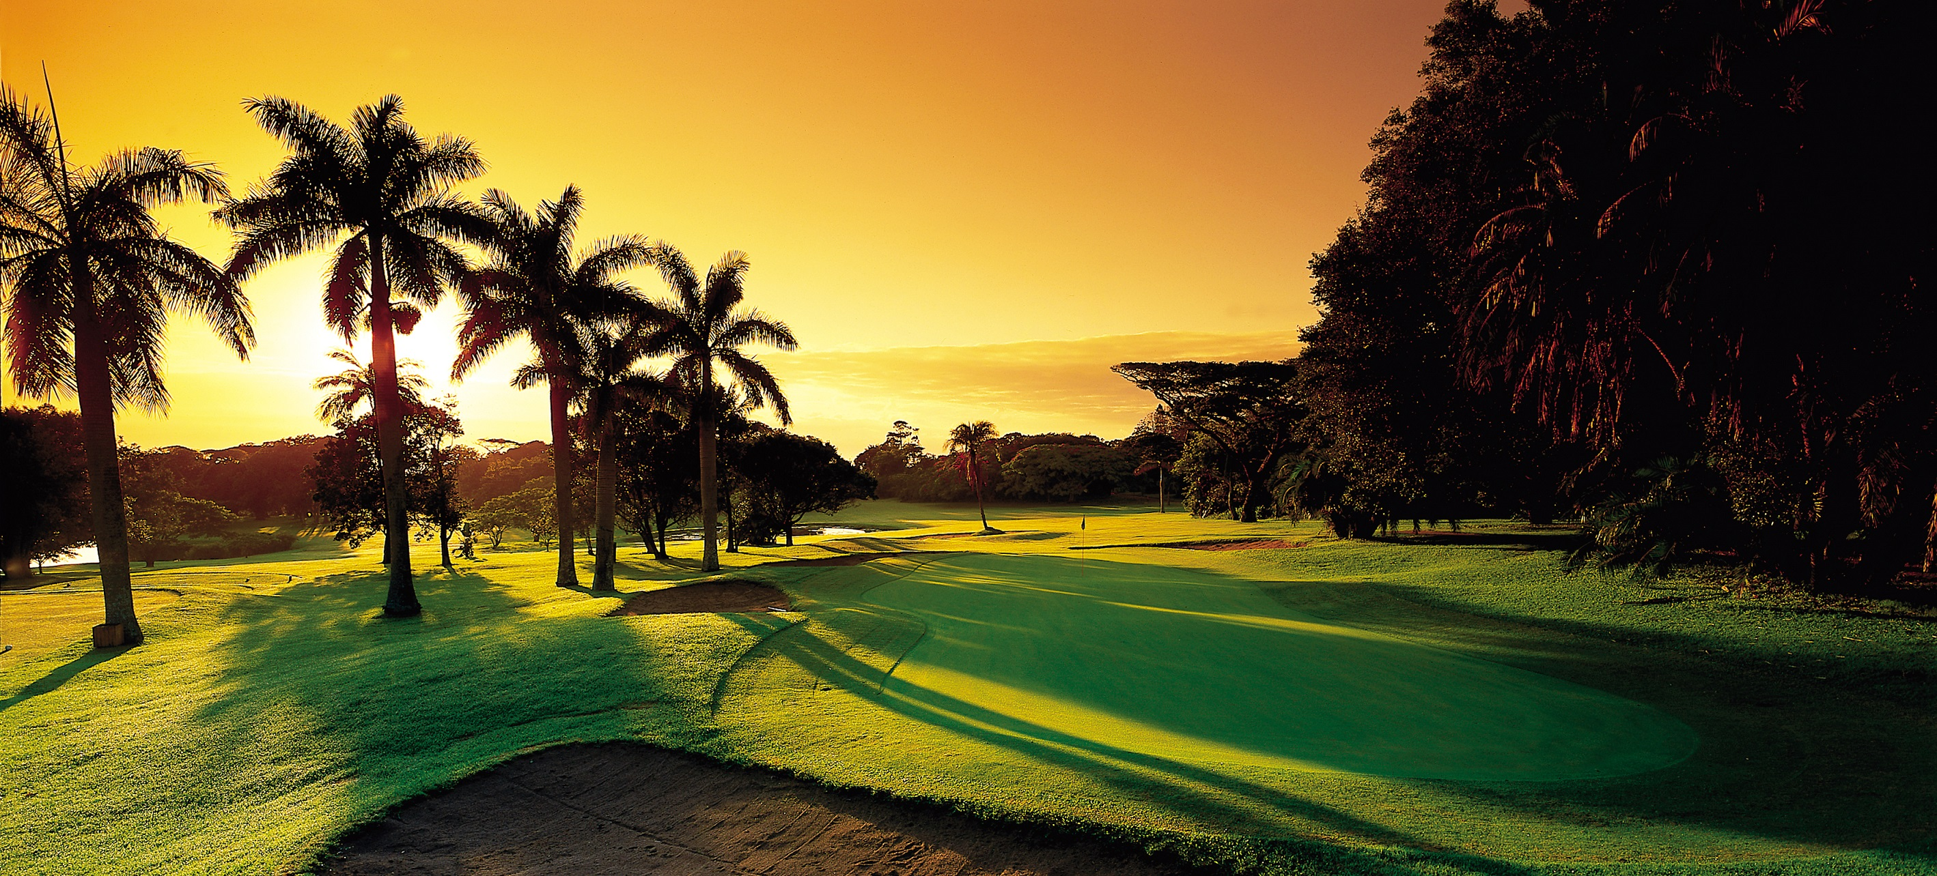
The Opportunity To Experience The South Coast’s Golf Courses
DAY
ACTIVITY | TEXPERIENCE / UNIQUE OFFERINGS | CONTACT DETAILS
Selborne Golf Club | A True Hidden Gem of the South Coast Our meticulously groomed, breath taking 18-hole, Par 72 golf course is designed to offer golf enthusiasts of all skill levels the opportunity to indulge in the ultimate golfing experience. We have mastered the art of blending top-tier quality with a family-friendly ambiance, making it the ultimate destination for an unforgettable golfing experience. At Selborne, our primary goal is to deliver exceptional products and service that enhance our customers golfing experience. We ensure your golfing satisfaction from the moment you arrive at our Estate. We believe that top-tier quality should be accessible to all. That’s why we offer our premium offerings at prices that are affordable for everyone. | 039 688 1800 proshop@spge.co.za
Umdoni Park Golf Club | Umdoni Park Golf Club, one of the hidden treasures of the South Coast, boasts breath-taking sea views from 70% of the golf course and is situated in 200 hectares of indigenous coastal forest. The par 5 eighteenth and par 3 sixteenth holes are both elevated tees, which makes the length judgment critical. It is 18 holes over truly striking terrain, with the front 9 running alongside the sea and the back nine stretching inland through dense indigenous forest vegetation. Umdoni park is anything but flat and it’s elevation changes not only translate into an adventure of judgment and shot-making but provides any number of “view-site moments”. | 039 975 1615 proshop@umdonipark.com

Slide 4

The Opportunity To Experience The South Coast’s Golf Courses
DAY
ACTIVITY | EXPERIENCE / UNIQUE OFFERINGS | CONTACT DETAILS
Port Shepstone Country Club | The gem of the South Coast and just an hour’s drive from Durban, the Port Shepstone Country Club stands tall today as one of South Africa’s favourite golfing courses and estates. The course is set alongside the stunning Umzimkhulu River and the Indian Ocean. | 039 695 0140/1 reception@pscc.co.za
Harding Country Club | Harding, a small town nestled in a dairy and timber-farming area, sits at the foot of the majestic Ingeli Mountain Range in the Mzimkulwane River Valley and is surrounded by ancient indigenous forests. The Harding Golf Club is a scenic 78-kilometre drive inland from Port Shepstone and offers a welcome relief from the coastal winds found at the coastal golf courses. | 039 433 1738 hardingcountryclub1@gmail.com

Slide 5
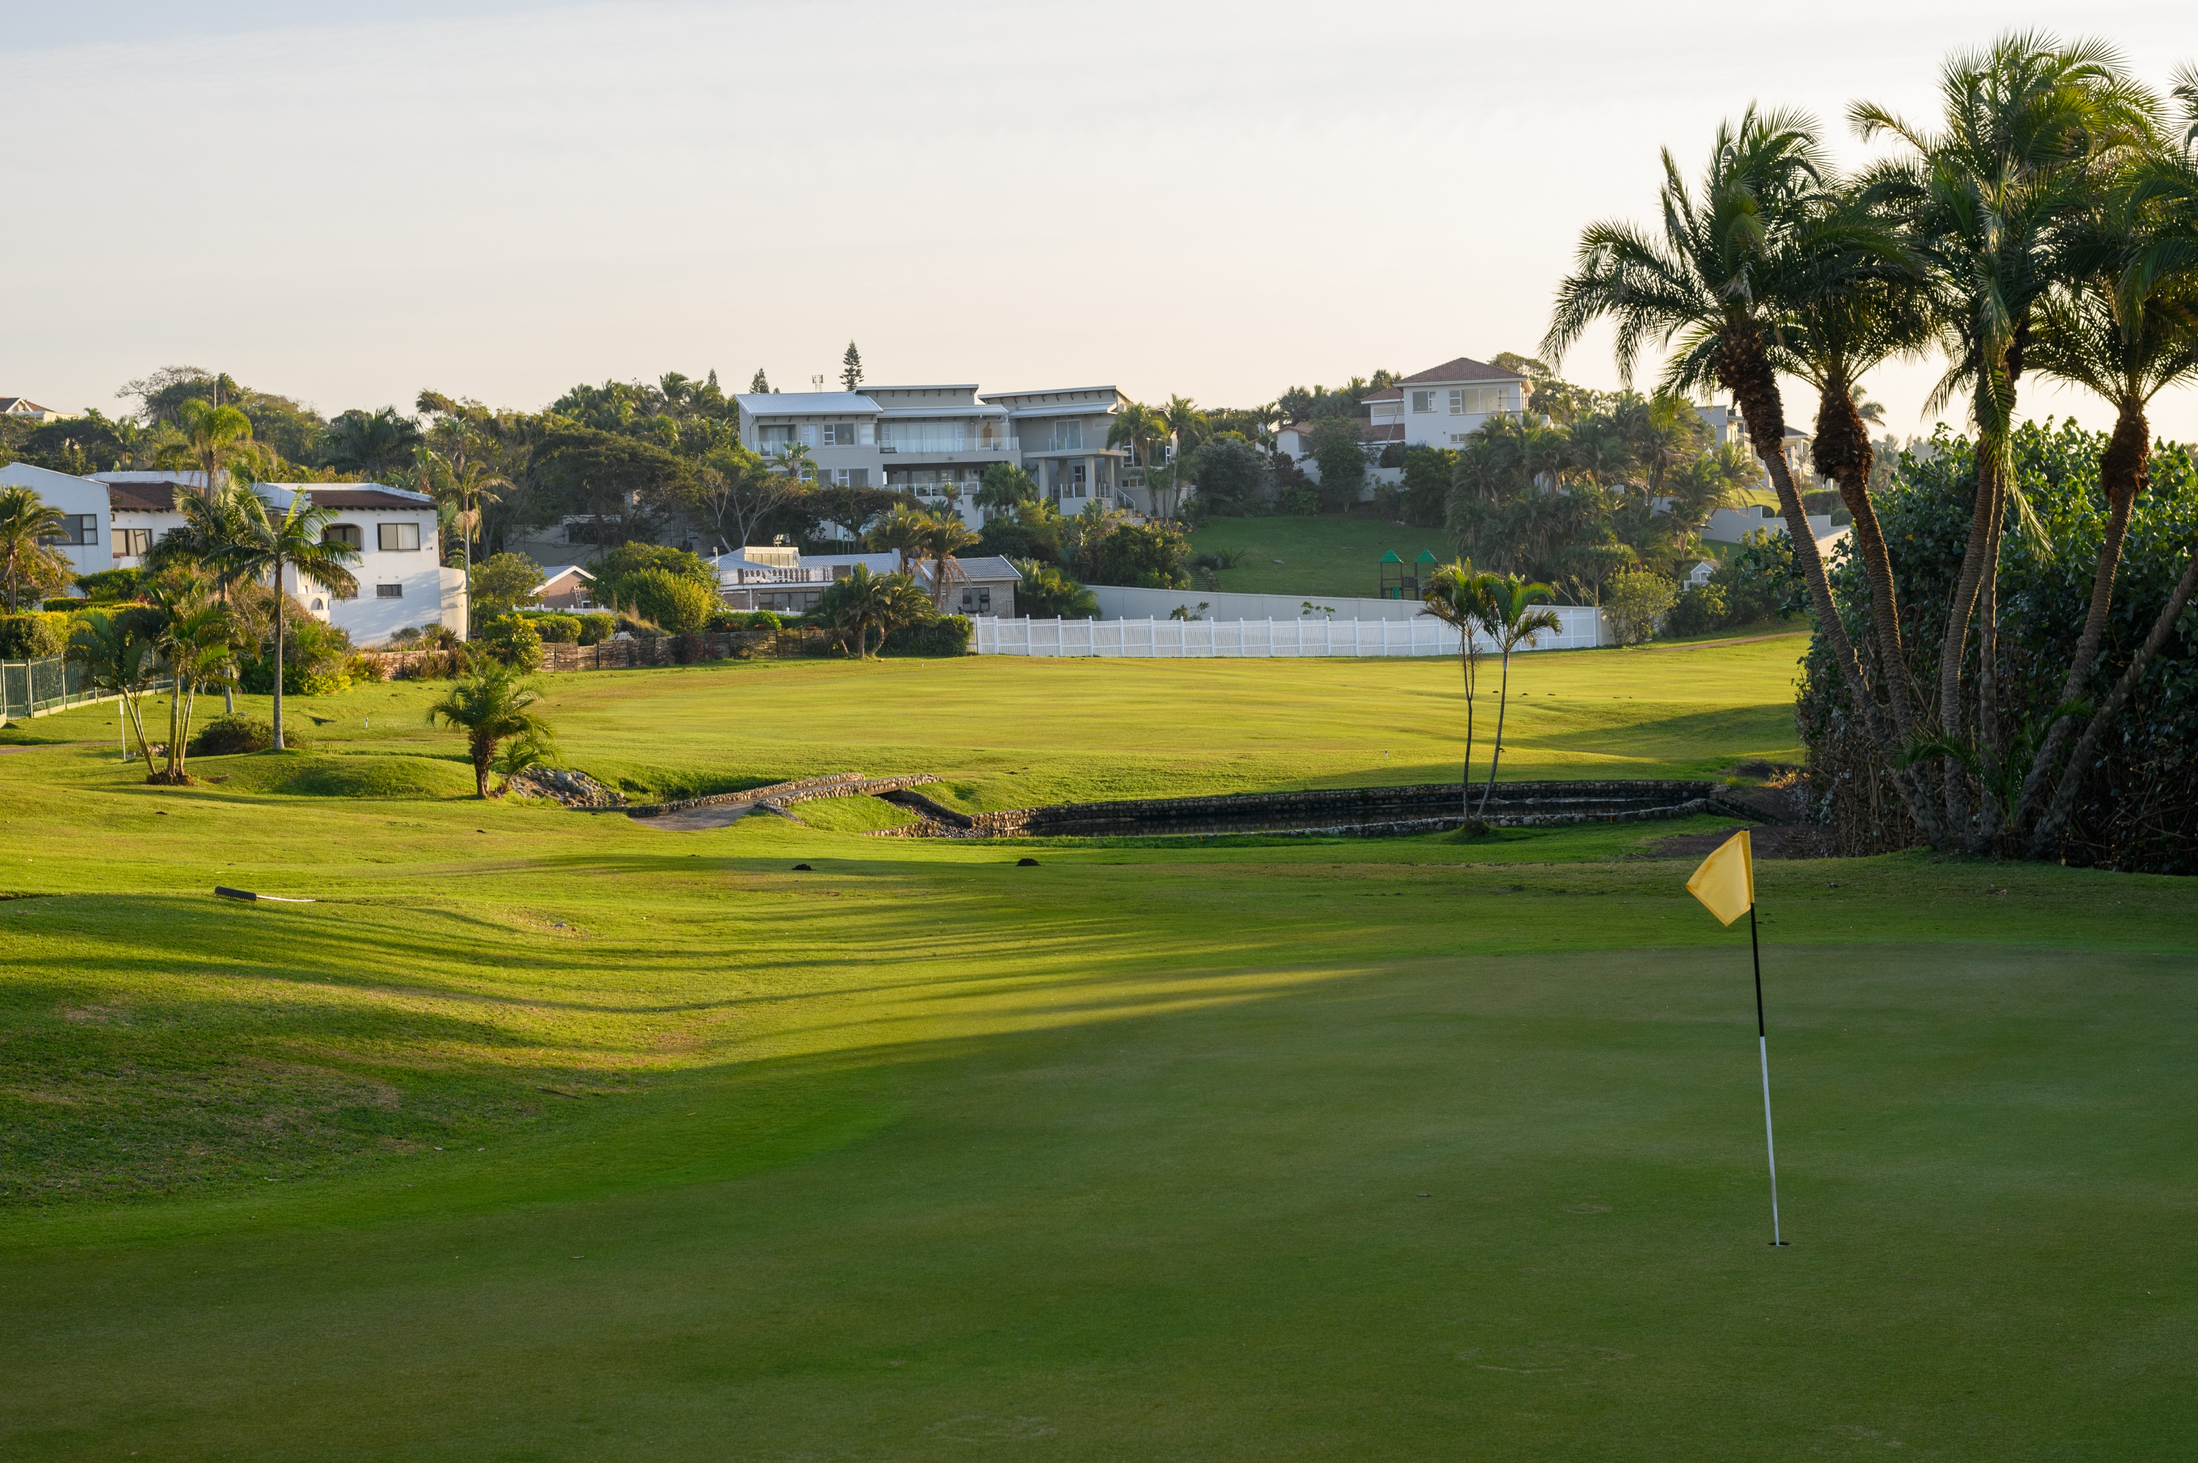
The Opportunity To Experience The South Coast’s Golf Courses
DAY
ACTIVITY | EXPERIENCE / UNIQUE OFFERINGS | CONTACT DETAILS
Margate Country Club | The Margate Country Club hosts one of the finest golf courses on the South Coast of KwaZulu Natal (East Coast of South Africa). Situated on the outskirts of Margate, we are right at the heart of KZN’s Hibiscus Coast and just over an hour’s drive from the City of Durban, with quick and easy access off the R61. You will feel very welcome at the Club, as we are dedicated to ensuring all members and visitors of a venue that offers friendship and social interaction, in a relaxed and comfortable environment | 039 312 0571 reception@margatecountryclub.co.za
Southbroom Golf Club | Only a stone’s throw from the Indian Ocean, Southbroom Golf Club affords golfers impressive views of pristine beaches and the sea; the tranquillity of playing alongside the lush indigenous vegetation of the Frederika Nature Reserve; and an opportunity to feel the pride of the Southbroom village as the course meanders past elegant coastal residences. | 039 316 6026 play@southbroomgolfclub.co.za

Slide 6
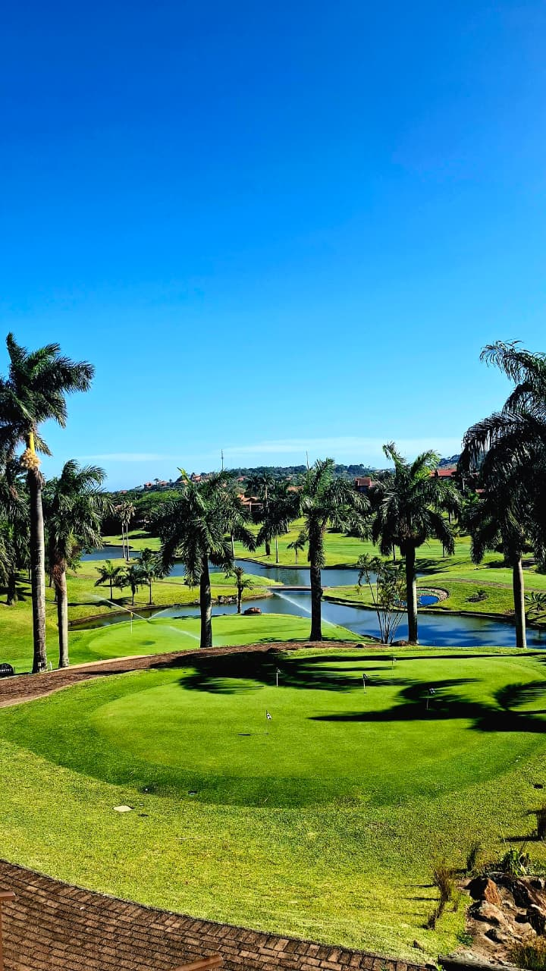
The Opportunity To Experience The South Coast’s Golf Courses
DAY
ACTIVITY | EXPERIENCE / UNIQUE OFFERINGS | CONTACT DETAILS
San Lameer Country Club | San Lameer is a conservation haven with 195 different bird species, abundant wildlife - including Impala, red, grey and blue Duiker, Reedbuck and Bushbuck - and indigenous fauna and flora. Add to this a subtropical climate, the Indian Ocean and, of course, a championship golf course and you have a golfer's paradise where Eagles and Birdies of all kind abound. Set in the heart of this unique natural environment, San Lameer offers you everything you would include in a dream course. Eighteen memorable holes that weave a natural challenge through the open glades, forest and wetlands with the relaxed roar of the Indian Ocean cheering you on. Enjoy a demanding round of golf on the 18 hole championship golf course designed by Peter Matkovich and Dale Hayes or a more relaxed 9 holes on the Pitch and Putt course. The course itself is sculptured around one of the last remaining wetland forests on the South Coast of Kwa-Zulu Natal. It was designed to avoid areas of sensitive vegetation and utilizes the indigenous plants and shrubs in the natural features of the course. The club house is recognized as one of the most attractive in South Africa with spectacular views from the spacious terraces surrounding it. | 039 313 5141 gm.golf@sanlameer.co.za
Port Edward Country Club | Port Edward Country Club - a scenic 9 hole, 18 tee box, par 72 golf course with reputedly the friendliest atmosphere on the South Coast. | 039 492 0508 admin@portedwardgolflub.co.za

Slide 7
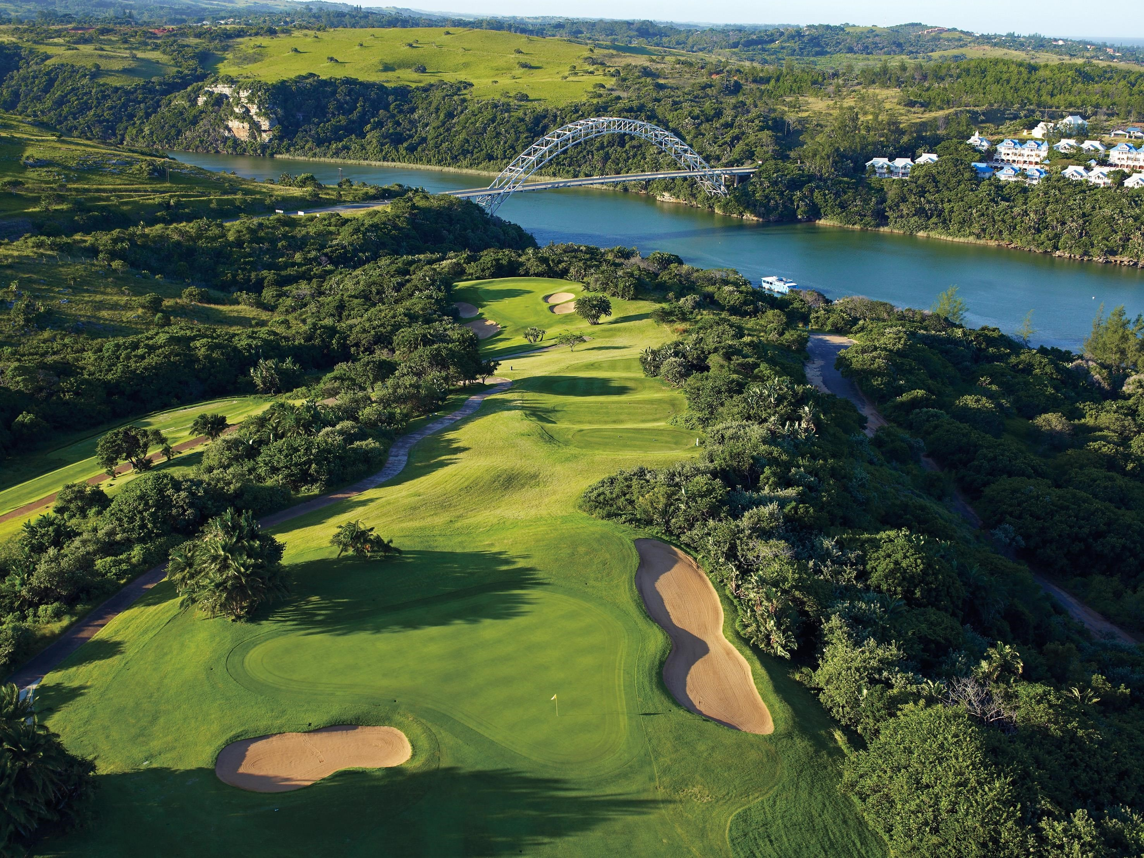
The Opportunity To Experience The South Coast’s Golf Courses
DAY
ACTIVITY | EXPERIENCE / UNIQUE OFFERINGS | CONTACT DETAILS
Wild Coast Sun Country Club | Home to a challenging 18-hole championship golf course that stretches along the expansive Wild Coast in the Eastern Cape, the Wild Coast Sun Country Club forms part of the South African PGA circuit. With its par-70 card rating, the course boasts magnificent ocean views and magnificently curated fairways and greens. Opened in 1983, many golfers insist that this coastal course is one of the most beautiful golfing ranges in South Africa. However, the course offers more than just pretty fairways and well-kept greens. The course’s architect, Robert Trent Jones Jnr, made every effort to utilise the natural topography and geography of the region to its fullest. The result? A one-of-a-kind course that blends in with its natural surrounds. With its championship golf course and close proximity to Durban, the Wild Coast Sun is the ideal location for golfing holidays in the Eastern Cape. | 039 305 2799 wcsgolf@suninternational.com
 | For More Information | 039 682 7944 Info@sctie.co.za www.visitkznsouthcoast.co.za

