Slide 1
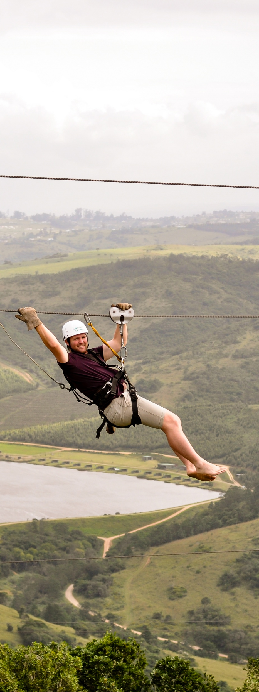
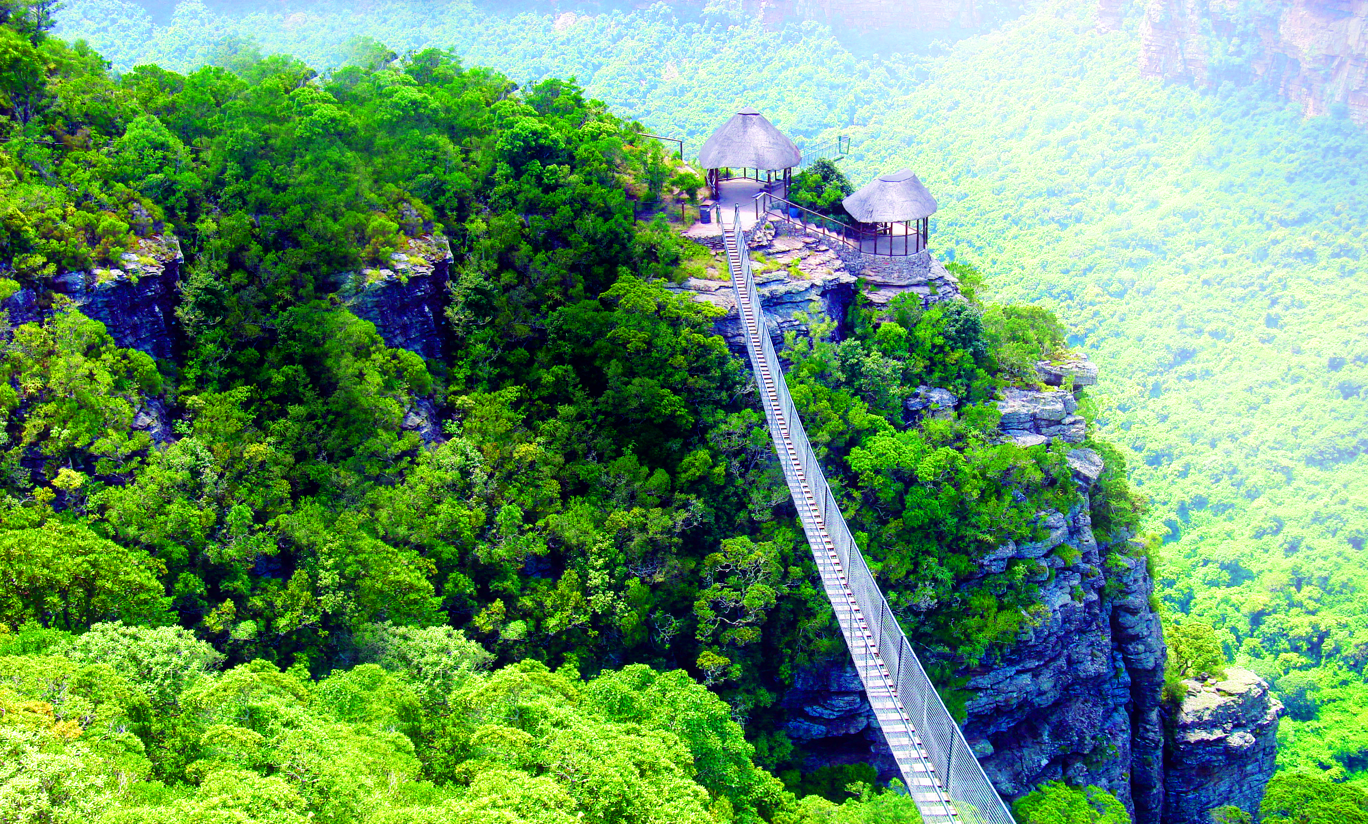
Oribi Gorge Adventure Experience

Slide 2
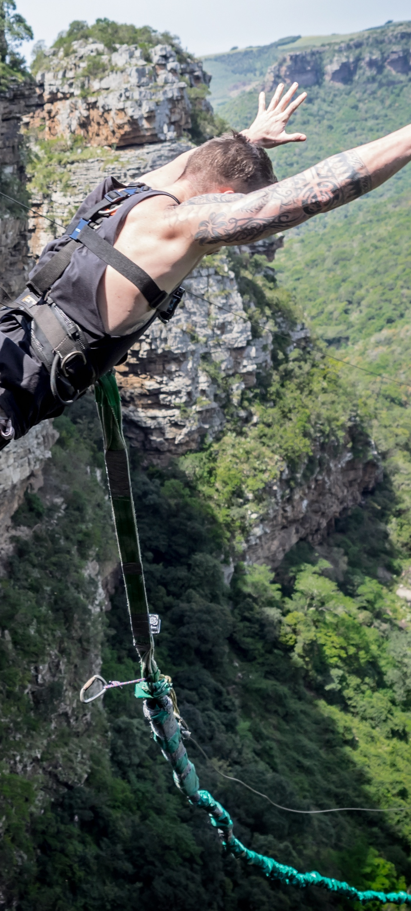
Oribi Gorge Adventure Experience
DAY
ACTIVITY | EXPERIENCE / UNIQUE OFFERINGS | CONTACT DETAILS
Oribi Gorge Area | . Oribi Gorge is a very scenic route, known for its for its breathtaking views of a deep gorge carved into ancient sandstone by the Umzimkulwana River. The area offers spectacular cliffs, lush forests, and multiple viewpoints accessible via hiking trails, making it a popular destination for nature lovers and photographers, and adventure seekers. Oribi Gorge features: . Wildlife: Home to a variety of wildlife, including leopards, and over 300 bird species including the breeding colony of rare Cape Vultures that can be viewed closely at a vulture hide and restaurant as part of a guided tour. . Activities: Includes highest gorge swing in the world, Africa’s longest and fastest zipline, suspension bridges, water rafting, abseiling, horse riding, game drives, cultural tours and more . Trails: There are many walking trails through the reserve, including self-guided trails . Viewing points: Includes the famous overhanging Leopard Rock viewing site. | 039 682 7944 info@scti.co.za
Oribi Gorge Wild5 Adventures | You’re not just anyone. You’re a thrill-seeker, a nature lover, an explorer at heart. You’re someone who craves the pulse of adventure in every breath, who finds joy in the leap and peace in the panorama. Welcome to Wild 5 Adventures, nestled in the awe-inspiring embrace of Lehr’s Falls in KZN, where we’ve embraced the spirit of Ubuntu in our approach to adventure. Here, there is something for everyone and the edge of the world isn’t a boundary; it’s a starting line. . The Wild Swing . The Wild Slide . Wild Abseil . Wild Quad Adventure . Suspension Bridge * Paintball . Hiking Trail . Team Building | 082 566 7424 info@wild5adventures.co.za

Slide 3
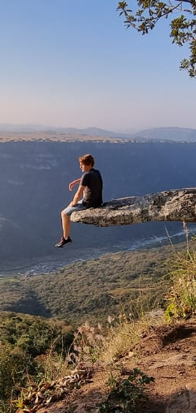
Oribi Gorge Adventure Experience
DAY
ACTIVITY | EXPERIENCE / UNIQUE OFFERINGS | CONTACT DETAILS
Oribi Gorge Lake Eland Game Reserve | A place of peace and tranquility. Covering an impressive 2500 hectares with diverse ecosystems of bushveld, grassland, coastal forest, wetland, and wild game, this natural landscape offers a place of peace and tranquility. . Zipline & Extreme Zipline . Self Guided Game Drive & Guided Game Drive . Suspension Bridge & View Sites . Horse Riding . Scooter Tour . x4 Track . Paint Ball . Mountain Biking, Fishing & Walking . Spa . Restaurant | 039 682 0395 reservations@lakeeland.co.za
The Gorge Private Game Reserve and Spa | This exclusive reserve combines luxury accommodation, wildlife encounters, and tranquil spa experiences, providing a secluded escape for couples seeking privacy and indulgence. | 039 687 4000 info@thegorge.co.za

Slide 4
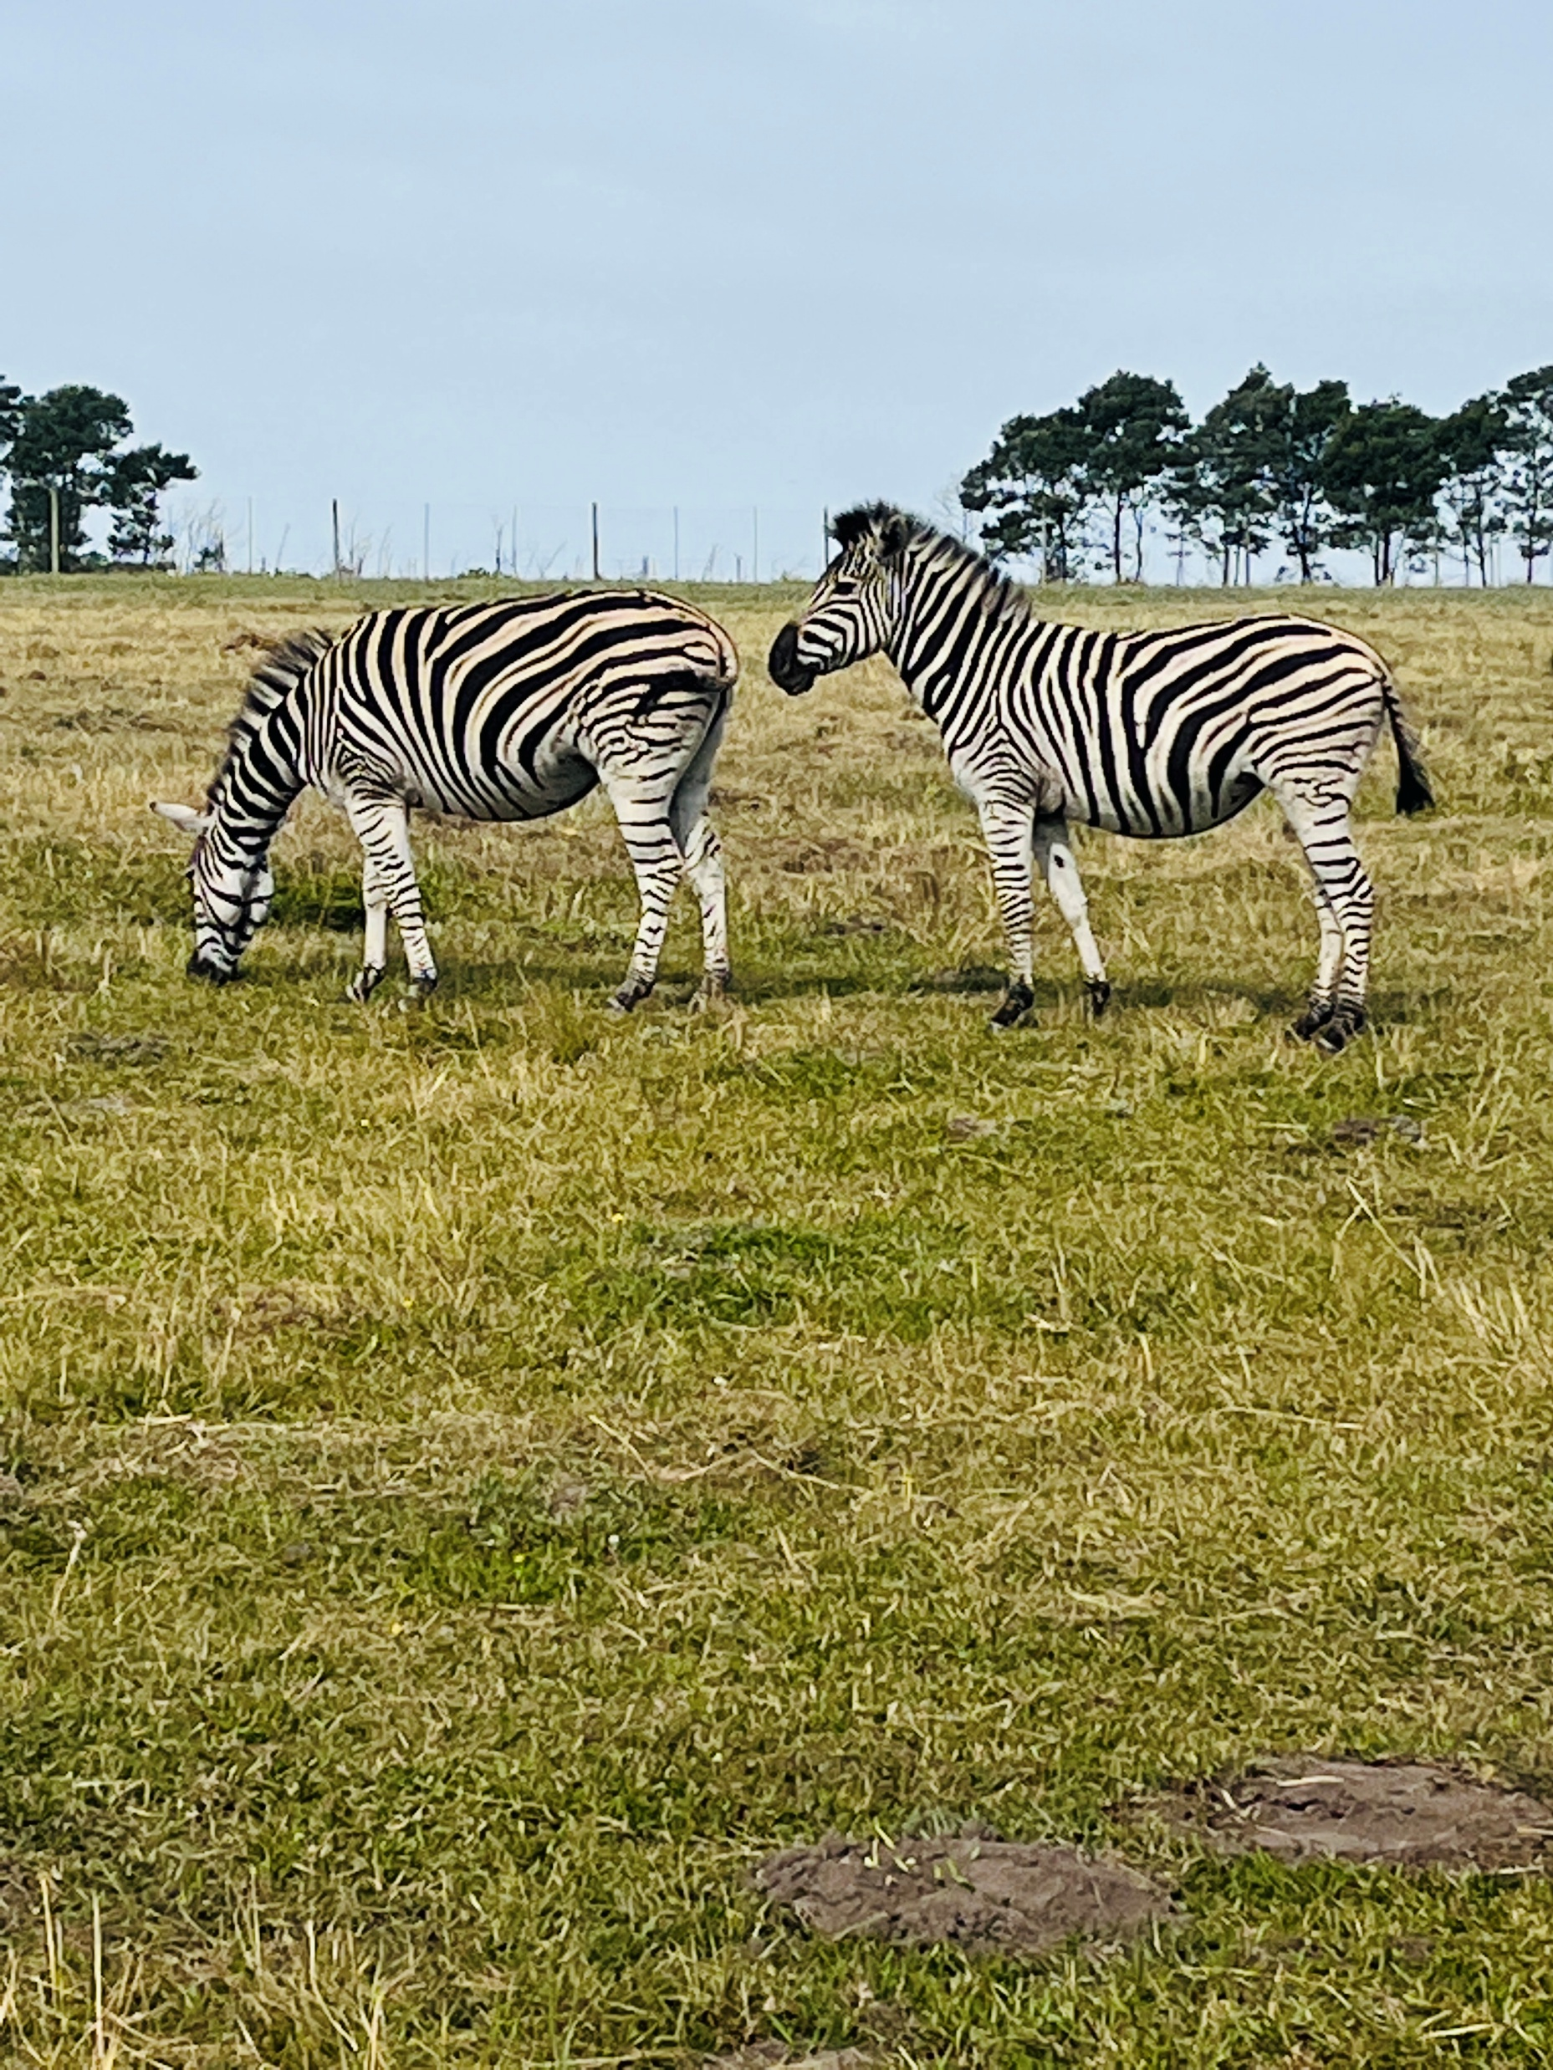
Oribi Gorge Adventure Experience
DAY
ACTIVITY | EXPERIENCE / UNIQUE OFFERINGS | CONTACT DETAILS
Leopard Rock Coffee Shop | . Leopard Rock Coffee Shop offers great food and coffee. . Panoramic views, making it an ideal spot for a casual date with a scenic backdrop. . Perfect for relaxed romantic moments, | 074 124 0902 leopardrockc@mweb.co.za
Oribi Gorge Nature Reserve | . There are numerous idyllic picnic spots on the banks of the river. . Many delightful walks and self-guided trails to the scenic spots in the reserve have been laid out. .Wildlife to be seen in the reserve includes species such as oribi, bushbuck, and common reedbuck, blue and grey duiker. Leopard occurs in the area. .The abundant birdlife in the reserve makes bird-watching a rewarding experience. . Details of these walks may be obtained from the reception office. | 039 400 0030 bookings@kznwildlife.com

