Slide 1
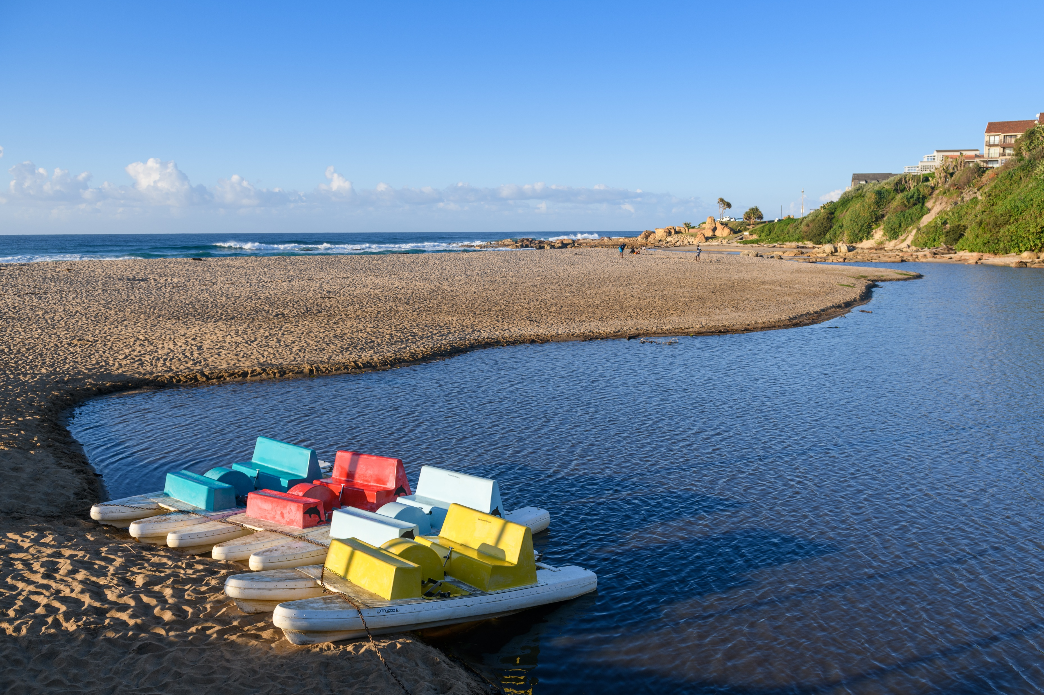
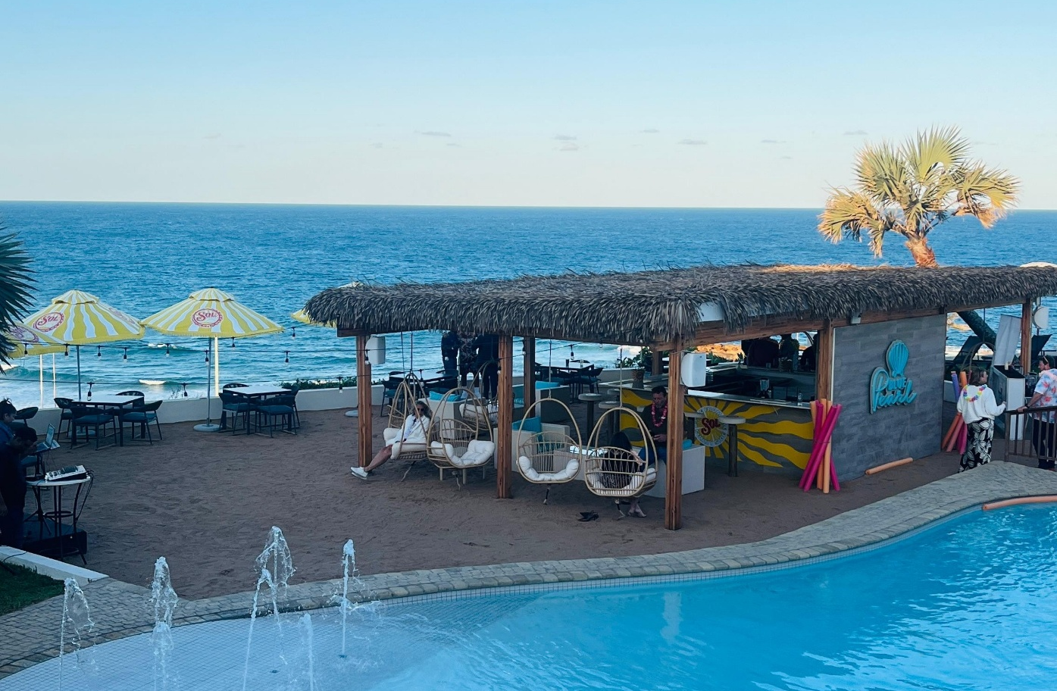
Beach & Bush Experience

Slide 2
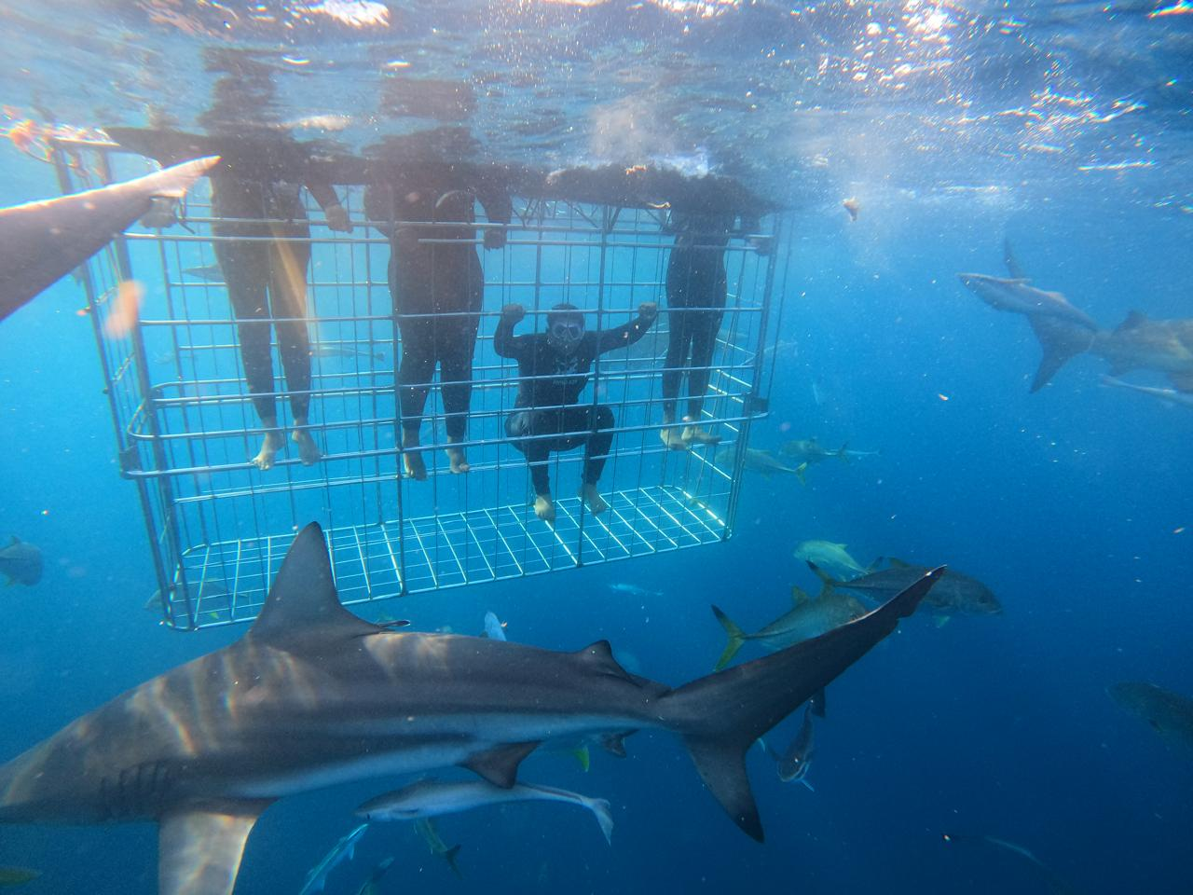
Beach & Bush Experience
DAY
ACTIVITY | EXPERIENCE / UNIQUE OFFERINGS | CONTACT DETAILS
Blue Marlin All-Inclusive Seaside Escape | . The Blue Marlin All-Inclusive Seascape is the only resort in the region offering an all-inclusive experience where everything is taken care of. . No frills, no fuss, no hidden costs. Be it families, friends, couples or corporates, the Blue Marlin All-Inclusive Seascape hits the mark for affordable, high-end holidays along the KwaZulu-Natal South Coast. . All this tropical tranquility is topped off with modern facilities and something-for-everyone adventures. . No need to fly abroad for that quintessential resort experience. It’s right here! | 039 978 3361 info@bluemarlin.co.za
Pumula Beach Hotel | Pumula Beach Hotel is unique in its location, situated right on one of the few select beaches in the country that enjoys Blue Flag status. . Between all the on-site facilities and those right on Pumula's doorstep, guests are indeed spoilt for choice. . Explore ever-ending golden beaches, protected bathing, rock pools, surfing, excellent fishing opportunities, the annual sardine run, and dolphin or whale watching to name a few. . The more adventurous are welcome to participate in these experiences and so much more. | 039 684 6714 reservations@pumulabeachhotel.co.za

Slide 3
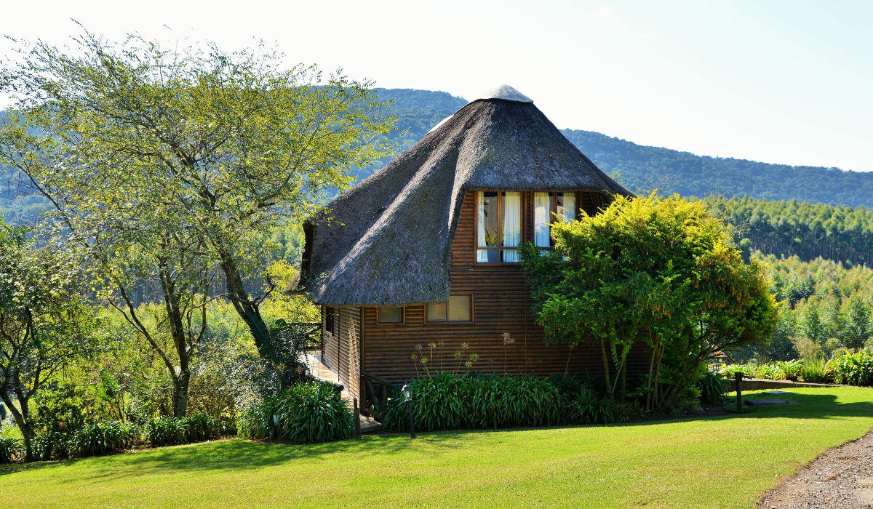
Beach & Bush Experience
DAY
ACTIVITY | EXPERIENCE / UNIQUE OFFERINGS | CONTACT DETAILS
Weza Hiking Trail | . The 8km Weza Hiking Trail starts in the iKhwezi rural area, approximately 10km from the farming town of Harding. . A trained local guide will take visitors from the junction of the Mawane and Weza rivers, the latter being a northern tributary of the mighty uMtamvuna River. . Visitors will traverse two amaKhosi areas, KwaMachi and KwaJali in Umuziwabantu, finishing at a real hidden gem, the Mkhoba Waterfall. . Hikers will enjoy some unique bird watching and wildlife spotting while crossing through indigenous forests and over rivers to incredible viewpoints. . Most of the area is covered with a green carpet of grass known as the Aristida. | 039 682 7944 info@sctie.co.za
ANEW Resort Ingeli Forest | . Take a break from the busy city and enjoy the combination of country living and comfortable accommodation. . Be indulged with fine food, outdoor activities in natural surroundings, and relaxation. . . ANEW Resort Ingeli Forest is nestled below the Ingeli Mountain range near Kokstad in KwaZulu-Natal, surrounded by breath-taking indigenous forests, this is the perfect place for you to chill and unwind at your own pace. | 039 553 0600 ingelires@anewhotels.co.za

Slide 4
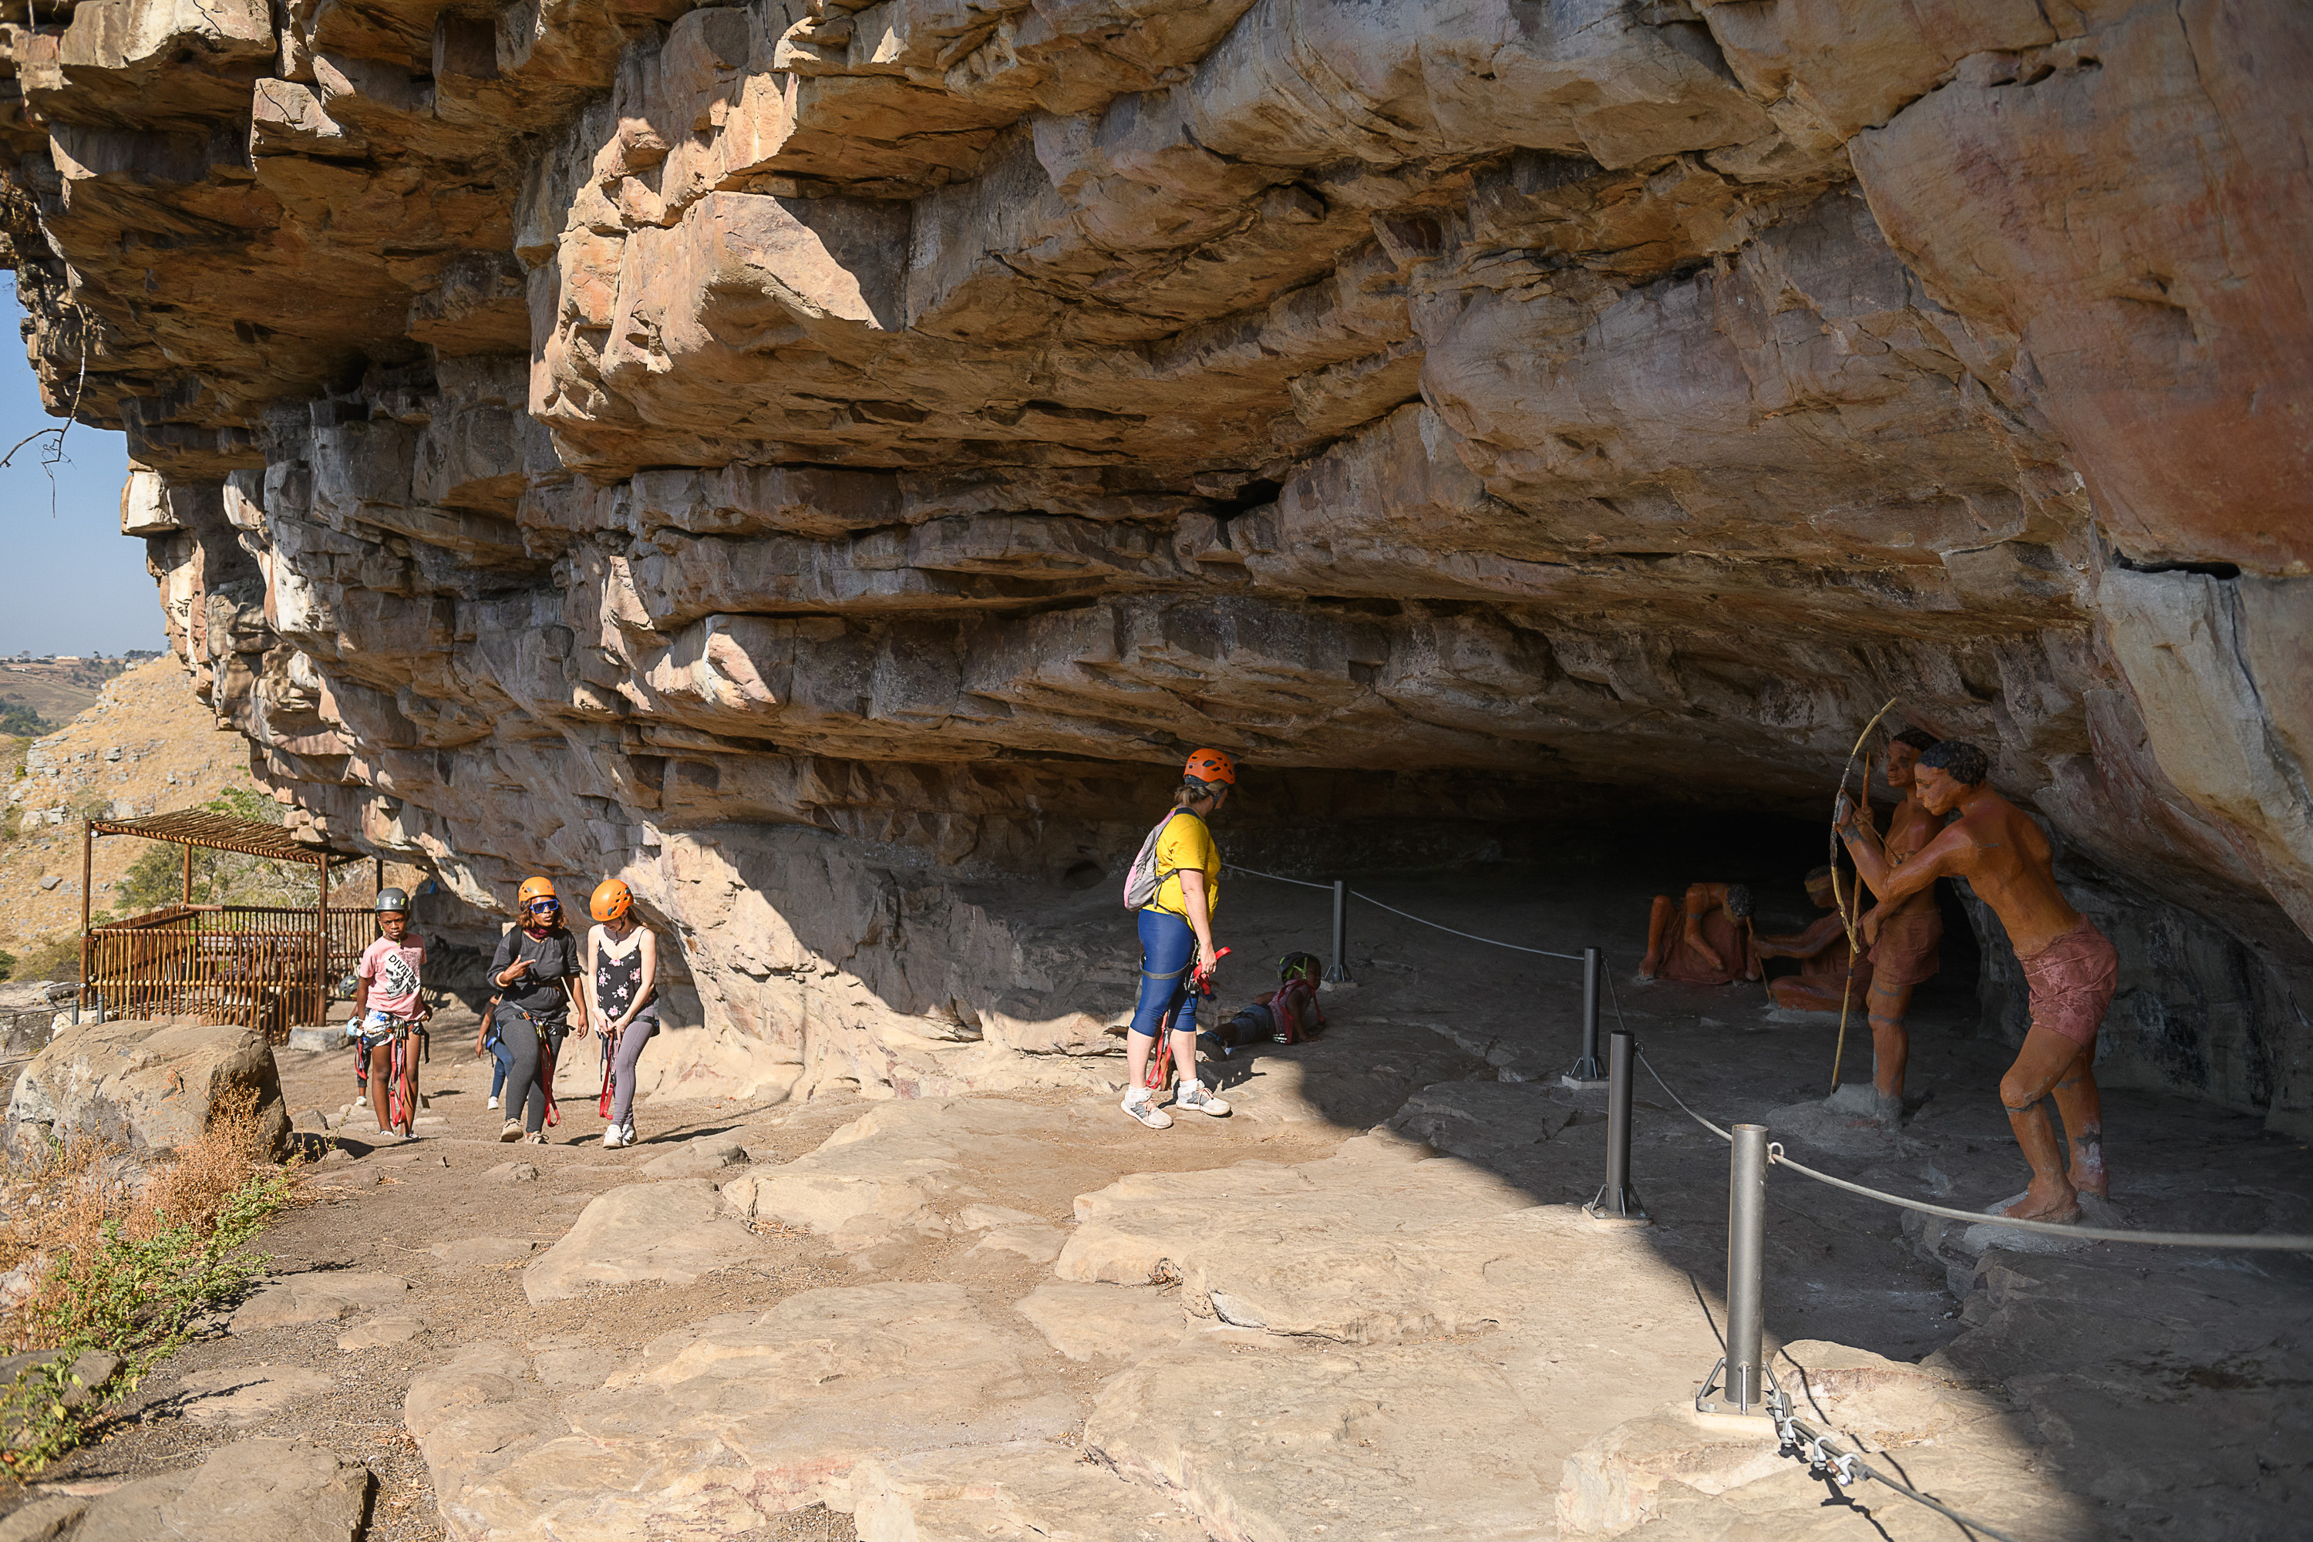
Beach & Bush Experience
DAY
ACTIVITY | EXPERIENCE / UNIQUE OFFERINGS | CONTACT DETAILS
KwaXolo Caves Adventure | . KwaXolo Caves have a preserved San paintings that are over 100 000 years old. These partially opened rock shelves served as shelters for San tribes that lived out in the area all that time ago. . It is believed that the sites held specific significance to the San people, which is expressed through the art found there. The paintings tell the rich story of culture and heritage. . To access the caves, a via Ferrata system (consisting of steel cables that are securely fixed into the rock) leads you up into the caves themselves. The adventure begins with visitors being strapped into safety gear and being led on a 5-minute hike to the caves by trained and registered guides. . This system allows guests to walk through the mountains with ease and a feeling of security. Other onsite facilities include a suspension bridge and picnic areas overlooking the waterfall. | makhanyashaun@gmail.com 0748873742
South Coast Diving Co. | . South Coast Diving Co, offer recreational scuba diving charters, PADI dive training from beginner to professional level, baited shark dives, and marine eco-tours from Shelly Beach . . The dive centre includes a retail shop, gear storage, and briefing facilities. | info@southcoastdiving.co.za 077-418-4857

Slide 5
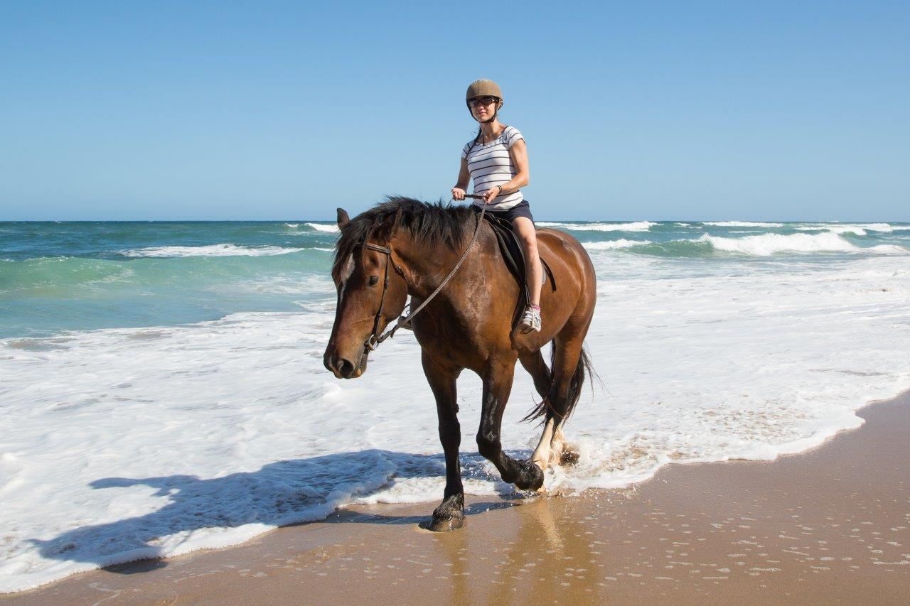
Beach & Bush Experience
DAY
ACTIVITY | EXPERIENCE / UNIQUE OFFERINGS | CONTACT DETAILS
Upside Down House | . This quirky attraction is a mind-bending experience where everything is, quite literally, upside down. . It’s a visual treat for kids, offering plenty of photo opportunities and a chance to experience the world from a different perspective. | 061 629 1704 monica@upsidedownhouse.co.za
Lake Eland Game Reserve | . Covering an impressive 2500 hectares with diverse ecosystems of bushveld, grassland, coastal forest, wetland, and wild game, this natural landscape offers a place of peace and tranquility. . Guests can walk across our 80m suspension bridge and get their hearts racing on our fabulous Zipline Tour. Other activities include horse riding, hiking, single track mountain bike trails, paintball, fishing, picnic sites and 4x4 tracks. | 039 682 095 Reservations@lakeeland.co.za
Selsdon Park Beach Horse Rides | . Your adventure awaits at Selsdon Park Estate Beach Horse Rides, where the beach, the sun, and the horses converge to create a truly magical experience. . Whether you seek a thrilling ride or a leisurely stroll along the shore, our horses are ready to take you on an unforgettable journey. | selsdonpark@icloud.com 083 301 2941

